Slide 1
Rockets
Airframe Assembly

Slide 2
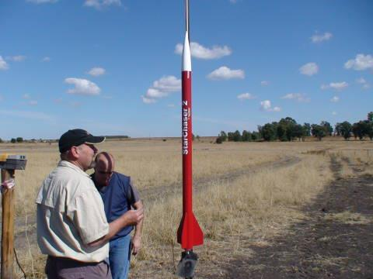
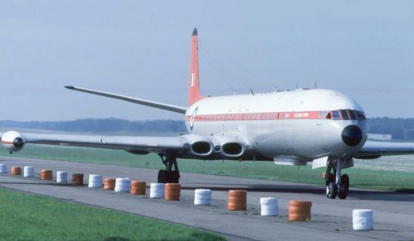
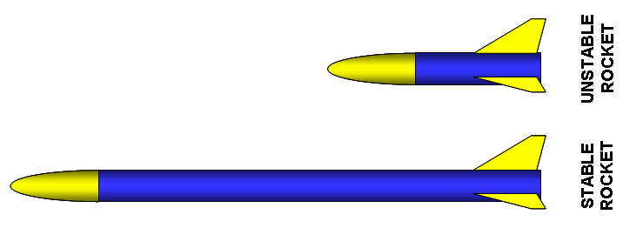

Slide 3
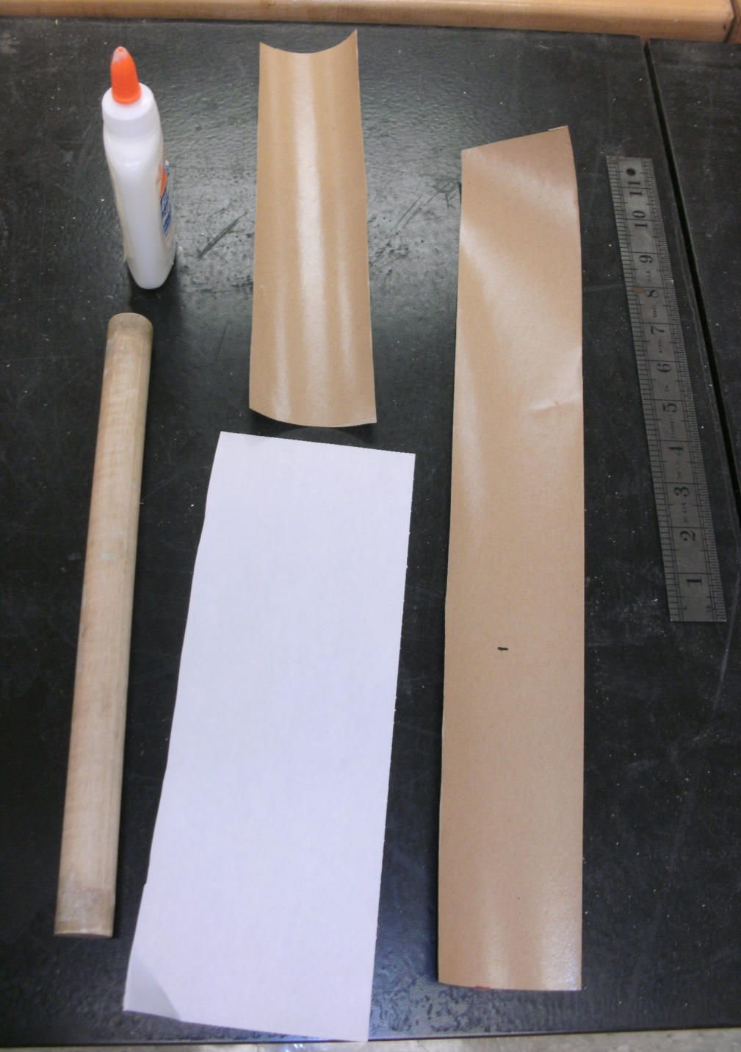
Your Airframe Assembly Needs:
12” length tube or wood dowel
Scissors
Wet paper towel
12” ruler
8-1/2 x 11 sheet of paper
29” of 3” wide gummed paper tape
Elmers glue
Paper towel
Drinking straw
Pencil/Pen

Slide 5
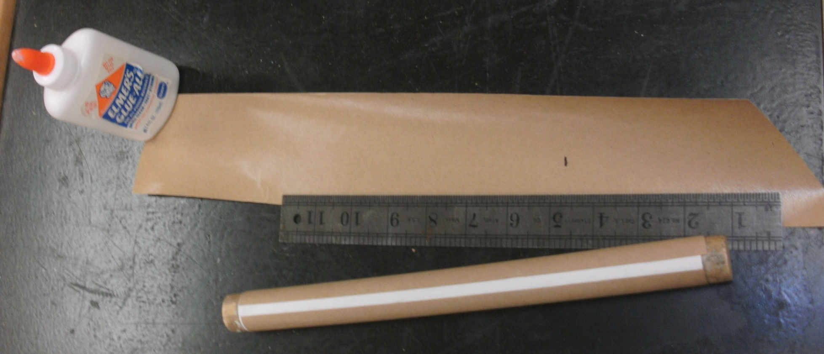
Airframe Assembly Directions:
1. Cut the 8-1/2 x 11” sheet of paper in 1/2 to make a 4-1/4 x 11”
piece. Wrap this piece tightly around the 1” dia. plastic tube and
apply a narrow bead of glue down the overlapped seam. Make sure
you DO NOT glue the paper to your tube!
2. Cut off an 11” piece of 3” wide gummed tape. Dampen the sticky
side with a wet paper towel and wrap it lengthwise around the paper
wrapped tube.

Slide 6
3. With the remaining 18” of the gummed tape, cut the one end off at a
45 degree angle.
4. Dampen and wrap the gummed tape around the tube at an angle as shown In the photograph.

Slide 7
5. Trim the end of your paper airframe
6. Take the dowel/tube out of your airframe and use it to draw a straight line on your airframe about 7” long off the end.
7. Cut the drinking straw to 3-1/4 inches long and glue it on
the line 3” off the end. (The top of the straw should be
6-1/4 of the end of the airframe)

Slide 8
Resources:
www.pitsco.com
www.estesrockets.com
www.NASA.com
http://images.google.com/

