Slide 1
Model Rockets
Nose and Parachute Assembly

Slide 2
1. Transfer the anchor pattern onto a piece of paper
(Pattern is on fin pattern layout page)
2. Cut 15” of shock cord from the roll
3. Glue and fold the shock cord to the anchor pattern
as shown below
4. Put glue on the anchor and glue it inside the top end
of your airframe. The anchor should be as far down
as you can reach with your finger into the airframe
tube.

Slide 3
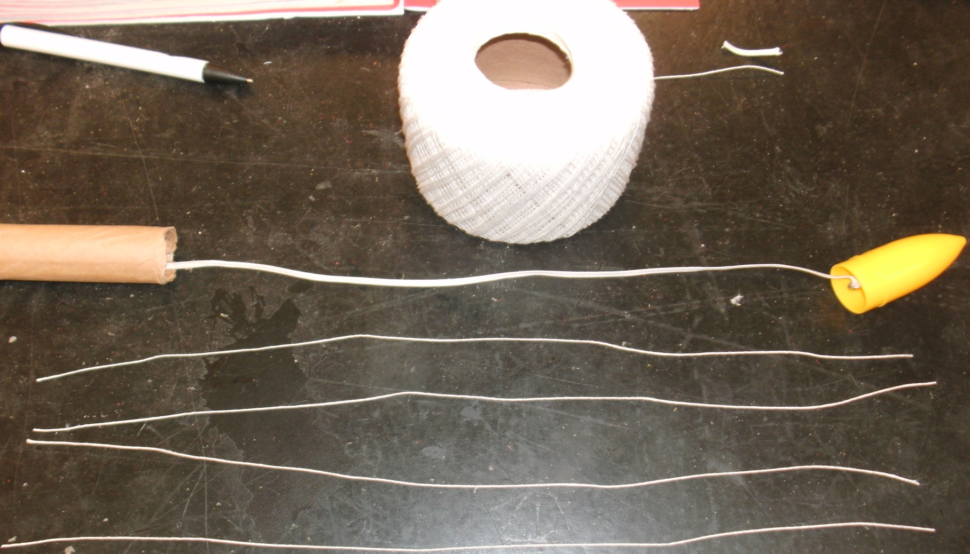
5. Tie the other end of the shock cord through the
eye screw.
6. Measure and cut four pieces of shroud line 14” long.
7. Tie one end of each shroud line to the eye screw and
then screw the eye screw into the nose cone

Slide 4
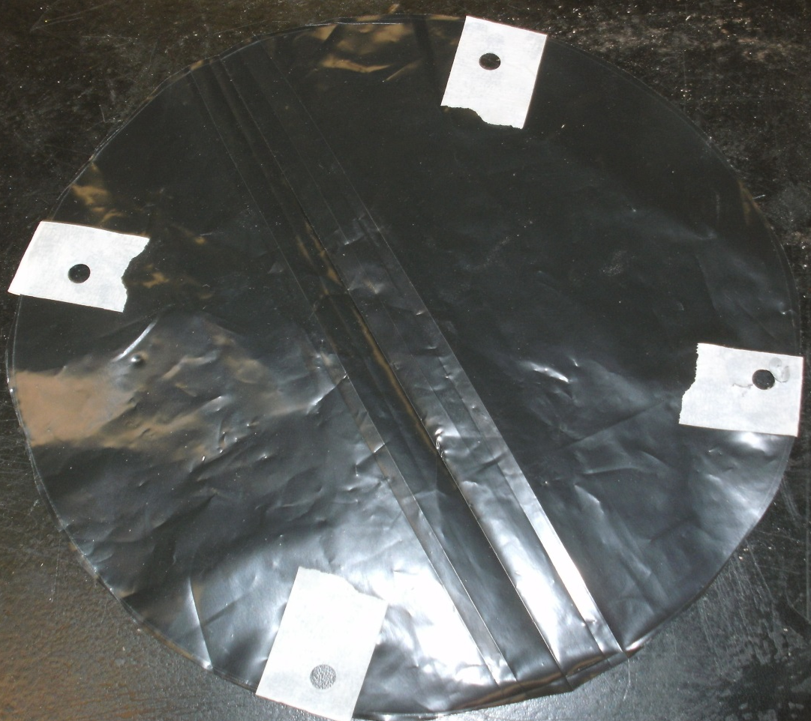
8. Use the round Masonite template to trace around
and cut out your parachute from a trash bag. *Big
is okay! Small is not good!
9. After you have cut out your circle, place masking
tape at 3,6,9, and 12 o’clock. Then use the hole
punch on each piece of tape.

Slide 5
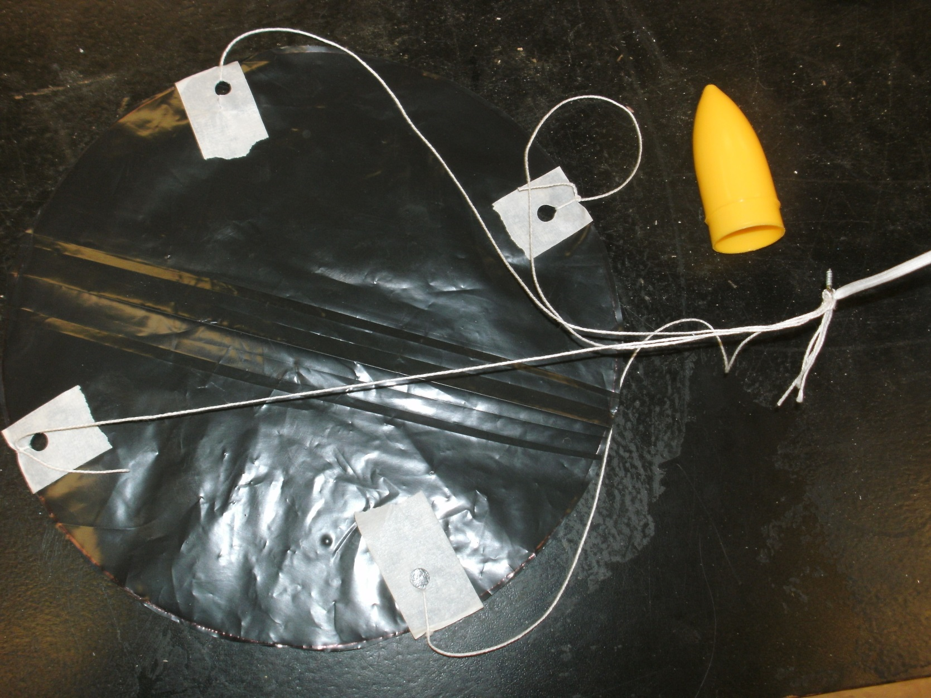
10. Loosely Tie the shroud lines to the parachute and
LIGHTLY wrap them around the parachute. Then
tuck all inside the airframe and insert the nose
cone after you screw the eye screw into the cone.
.

Slide 6
Resources:
www.pitsco.com
www.estesrockets.com
www.NASA.com
http://images.google.com/

