Slide 1
Model Rockets
6th grade Project
Model Rocket Project Overview

Slide 2
What do you Know about rockets and space? List everything you know on your worksheet
K-W-L Chart:

Slide 3
What do you Want to know about rockets and space? List everything you want to know on your worksheet
K-W-L Chart:

Slide 4
What did you Learn about rockets and space? List everything you learned on your worksheet
K-W-L Chart:

Slide 5
Did you know…
Model rockets are launched just like the
real ones: electrical ignition, launching
tower, and a countdown and
recovery system

Slide 6
Did you know…
The first recorded history of people using
rockets as a form of transportation occurred in
ancient China. A Chinese adventurer fixed 42
rockets to a chair. He then strapped himself into
the chair, fired the rockets, and soared high into
the air out of sight! He was never heard from
again. This of course ended, for centuries, man’s
Desire to use rockets as a means of travel.
Source: Technology Education Project Series by Boyd Hanks

Slide 7
What do rocket mean to you?
Make a list of all the different ways rockets affect your life!

Slide 8
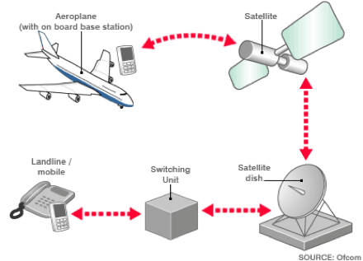
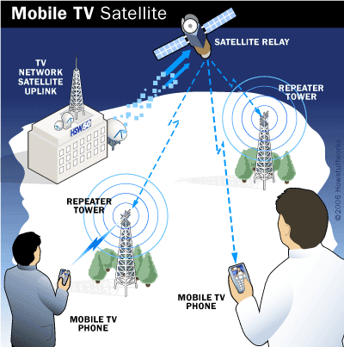
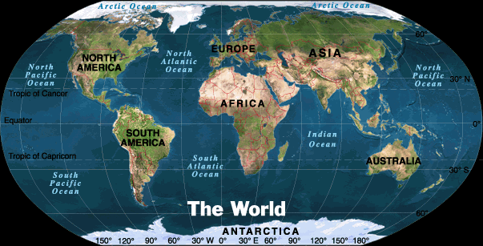
Entertainment…
Source: Technology Education Project Series by Boyd Hanks

Slide 9
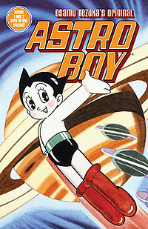
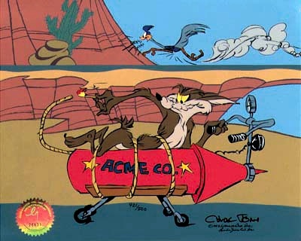
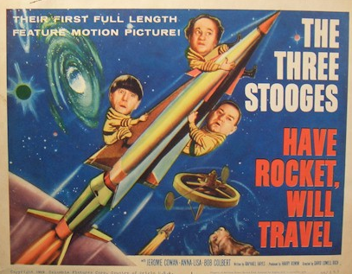
Entertainment (TV/Movies)...

Slide 10
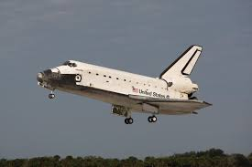
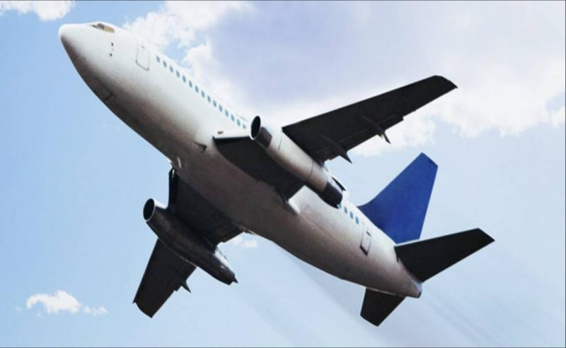
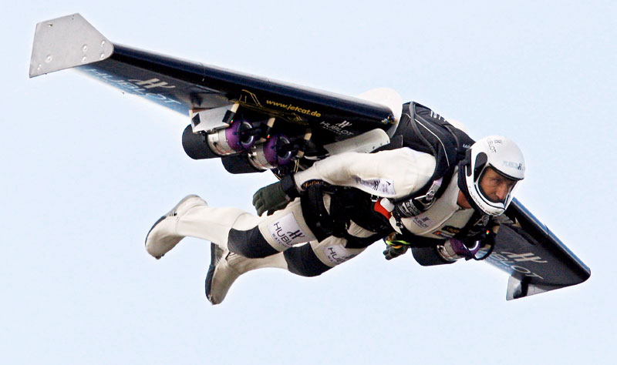
Travel...

Slide 11
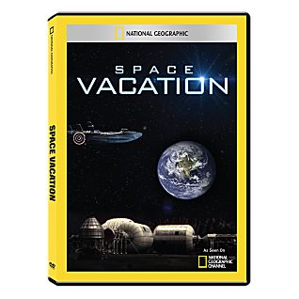
Vacation…
Source: Technology Education Project Series by Boyd Hanks

Slide 12
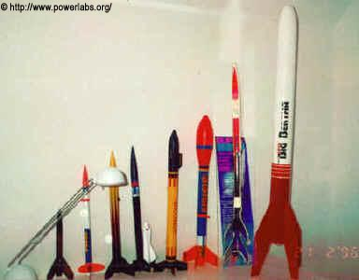

Slide 13
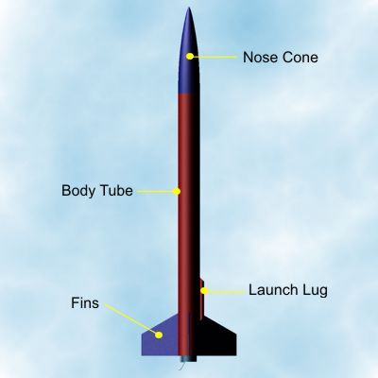

Slide 14
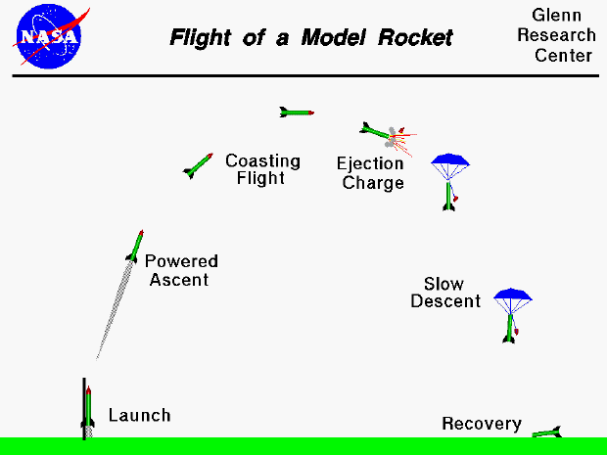

Slide 15
Web Links:
Things you may use rockets on?
http://weburbanist.com/2009/01/19/rocket-and-jet-powered-vehicle-designs/

Slide 16
Wrap up:
E06.C.1.1.1: Introduce claim(s) for the intended audience and support the writer’s purpose by organizing the reasons and evidence.
Write a 3 paragraph response to your
K-W-L Chart?
What I know
What I want to know
What I learned….so far

