Slide 1
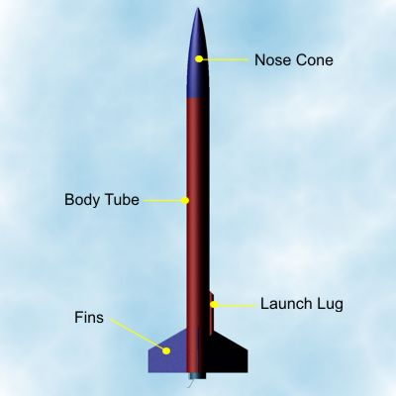
Rockets
Tail Fin Assembly
PA Standards
3.4.10.D1:
Refine a design by using prototypes and modeling to ensure quality
efficiency, and productivity of a final product.

Slide 2
Tail Fin
The fins provide the rocket with stability. The is further explained on NASA’s website. Please go there and see it along with pictures.
http://exploration.grc.nasa.gov/education/rocket/rktstab.html
PA Standards
3.4.10.D1:
Refine a design by using prototypes and modeling to ensure quality,
efficiency, and productivity of a final product.

Slide 3
Supplies Needed:
Scissors
Elmer's glue
3/32 thick binder board
Fin pattern
Dowel
Fin pattern worksheet
Glue gun
Glue gun sticks

Slide 4
Tail Fin Assembly Process:
Mark your airframe for the tail fins by using fin pattern spacing guide (on worksheet).
2. Draw 3 lines on the airframe
by using the wooden dowel as
a guide

Slide 5
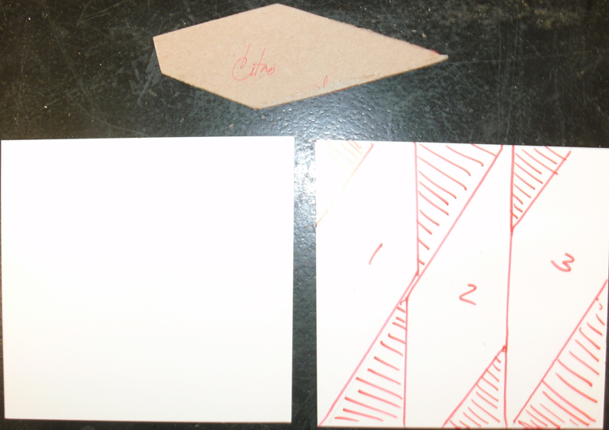
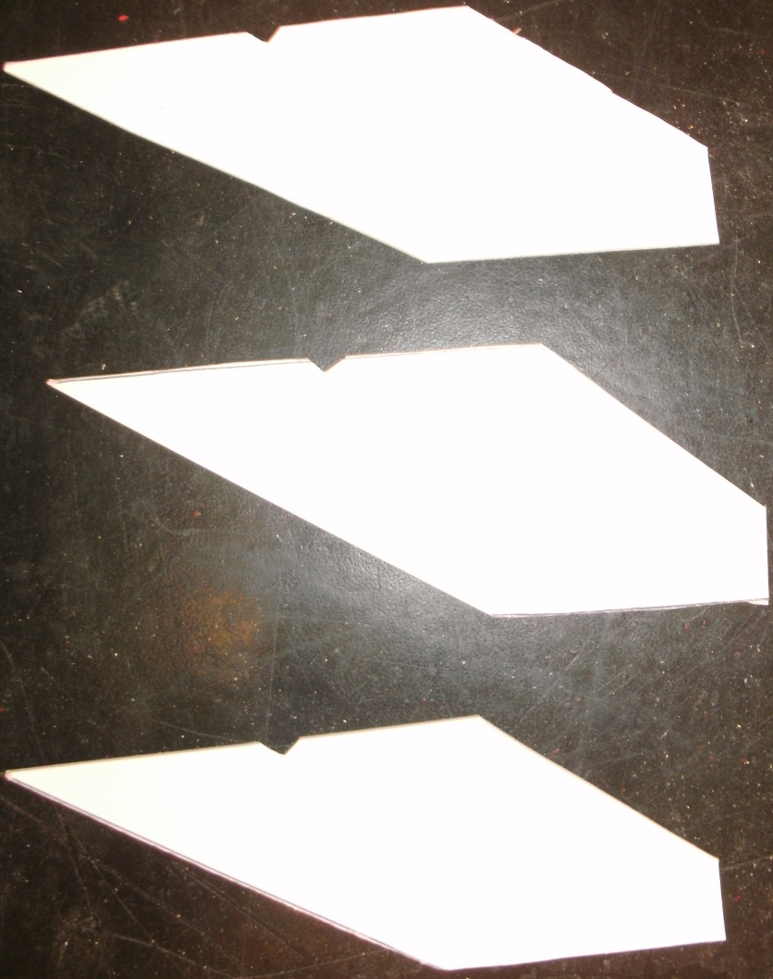
3.Trace the fin pattern onto your binder board
to make 3 fins then cut them out.

Slide 6
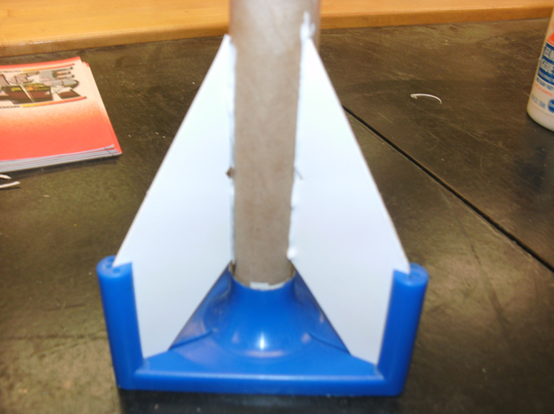

Slide 7
5.Once the glue has dried, use the glue gun to further secure the 3 fins and launch lug.

Slide 8
Resources:
www.pitsco.com
www.estesrockets.com
www.NASA.com
http://images.google.com/

